Slide 1
Evaluate Your Agents with AgentEval
Sankareswari Athiappan
8 Jul 2025
Notes:
28

Slide 2

Evaluating Agent
Git URL for Python File: https://github.com/Sankari-KK/new-learning/blob/main/NewfiletrywithAgentEval.ipynb
MD File: https://github.com/Sankari-KK/new-learning/blob/main/evaluation_result_2025-07-08_20-35-30.md

Slide 3
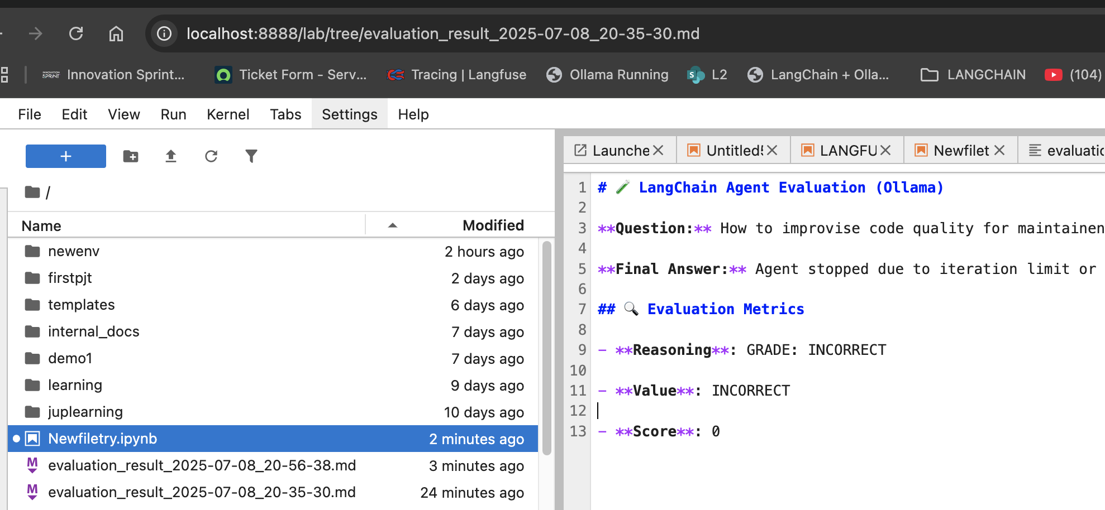
Screenshots

